Slide 1

Hospital Management & Analytics System
An End-to-End Data-Driven Solution

Slide 2
Project Overview
SQL Databas
Data Warehouse
SSIS ETL
SSRS Reporting
Web App
Dashboards

Slide 3

Why This Project?
Hospitals today deal with massive amounts of data—patients, staff, visits, billing, and diagnostics.
We started this project to solve key challenges:
- Centralizing all hospital data
- Supporting better workflow & care delivery
- Providing analytical reports for decisions
- Predicting patient risk using ML
- Scalable and smart system

Slide 4

Project Workflow
Data is generated from hospital operations
Stored in a normalized relational database
SSIS pipelines extract, transform, and load (ETL) the data
Data is loaded into the data warehouse
SSRS & web app use the Data Base for reporting and interaction
ML model is trained from warehouse data for classification

Slide 5
Database Overview
Main Tables:
Patients, Doctors, Visits, Bills, Rooms, Departments
Relationships:
Patient → Visits
Doctor → Appointments
Visit → Diagnostics
Purpose:
Daily hospital operations
Data consistency & normalization

Slide 6
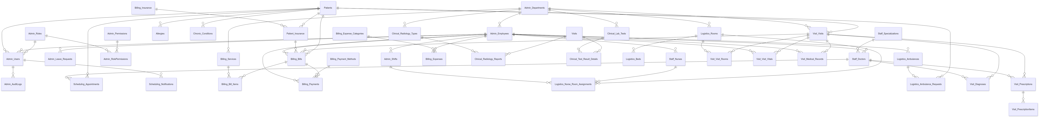
Erd

Slide 7
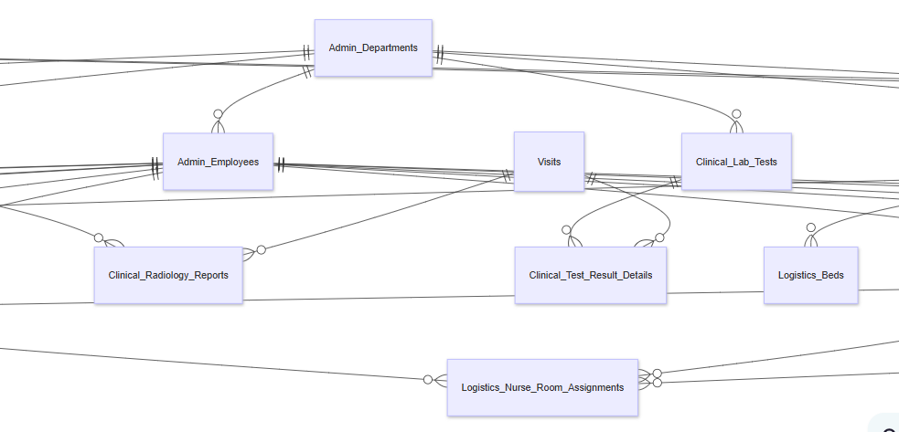
Erd-part

Slide 8
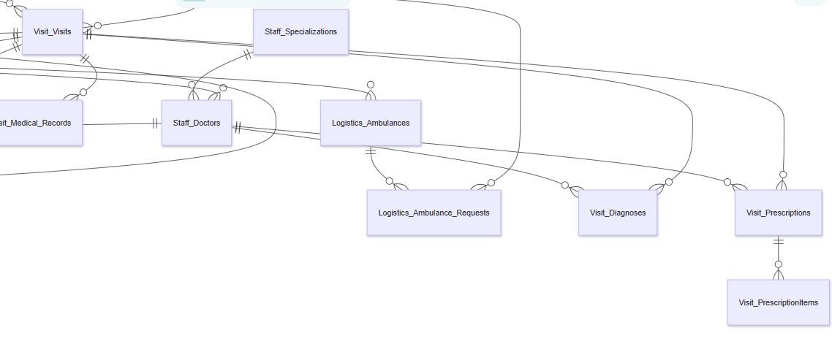
Erd-part

Slide 9
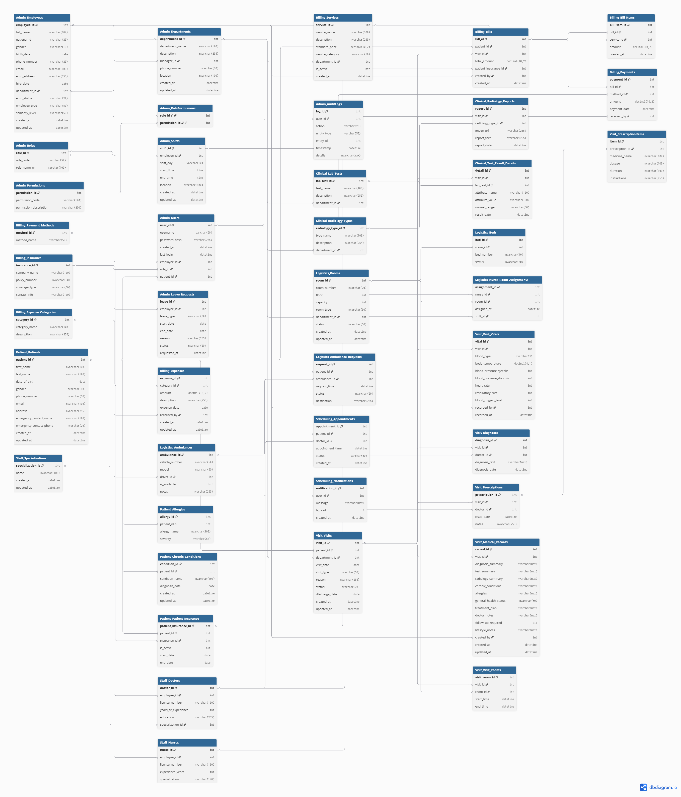
Table-mapping

Slide 10
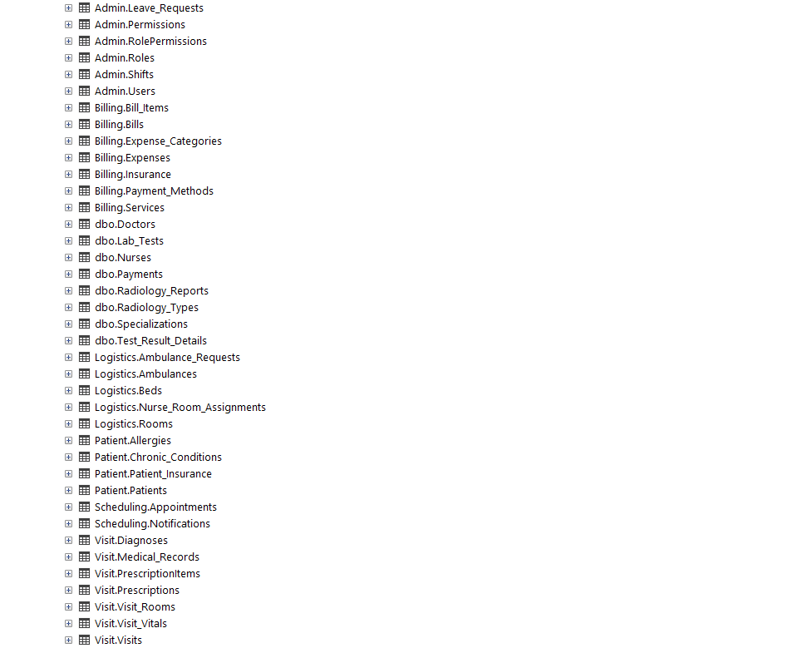
Tables in sql-server

Slide 11
Data Warehouse Overview
Fact Tables:
Fact_Visits, Fact_Billing, Fact_Clinical, etc.
Dimension Tables:
Dim_Patient, Dim_Doctor, Dim_Date, Dim_Department, etc.
Why Star Schema:
Easy to query & analyze
Power BI & SSRS ready
Supports time-based insights

Slide 12
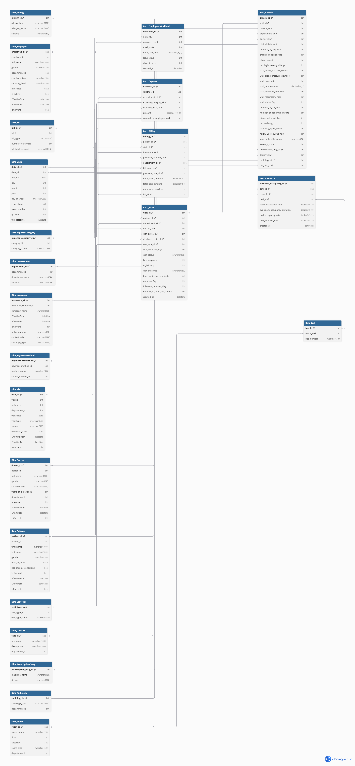

Slide 13
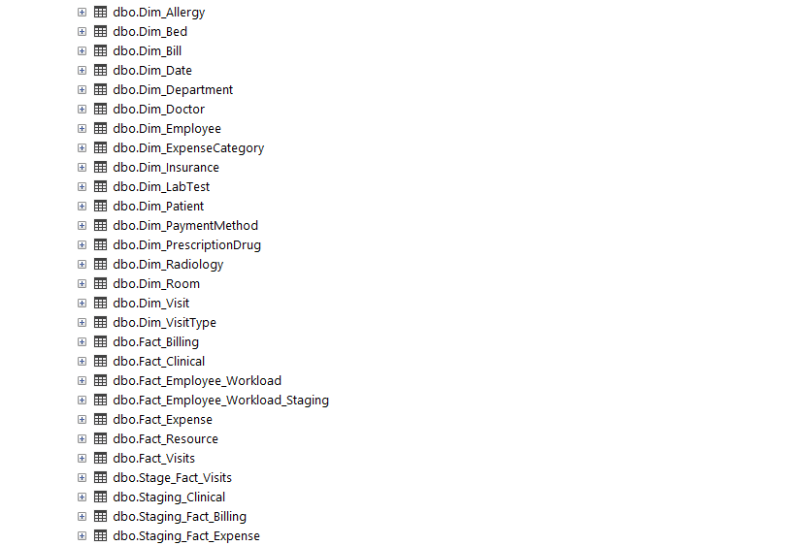
DWH IN SQL-SERVER

Slide 14
ETL using SSIS
Extract data from OLTP (SQL)
Clean, transform, and format
Load into the Data Warehouse
Scheduled with SSIS packages

Slide 15
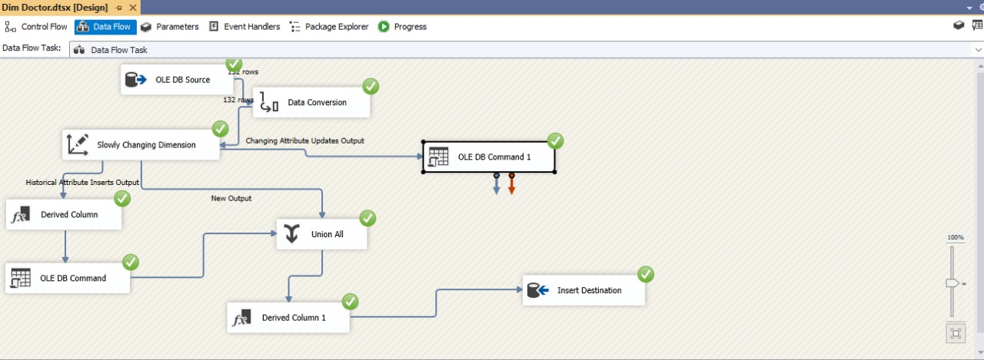
From doctor to dim_doctor

Slide 16
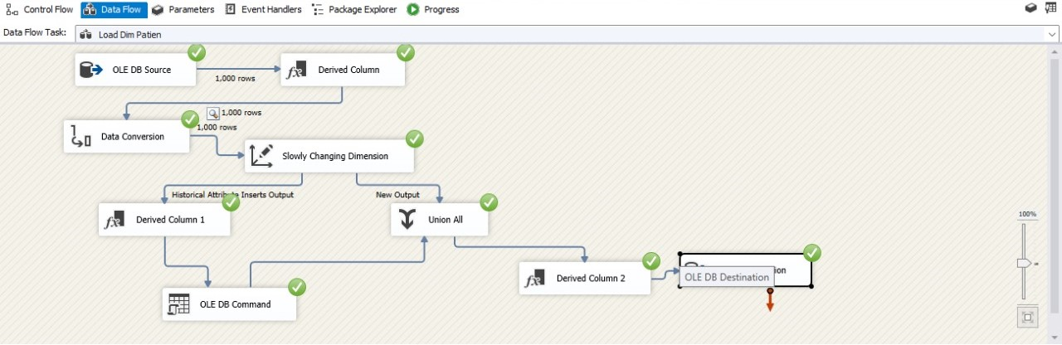
From patient to dim_patient

Slide 17
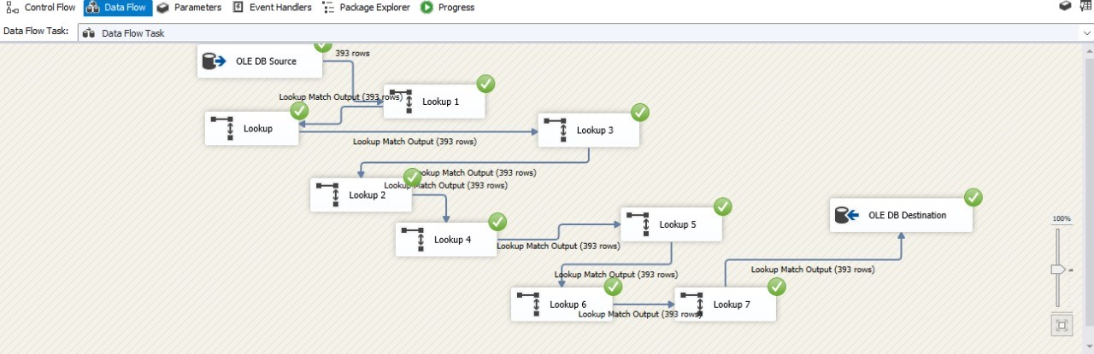
Creating Fact_billing

Slide 18
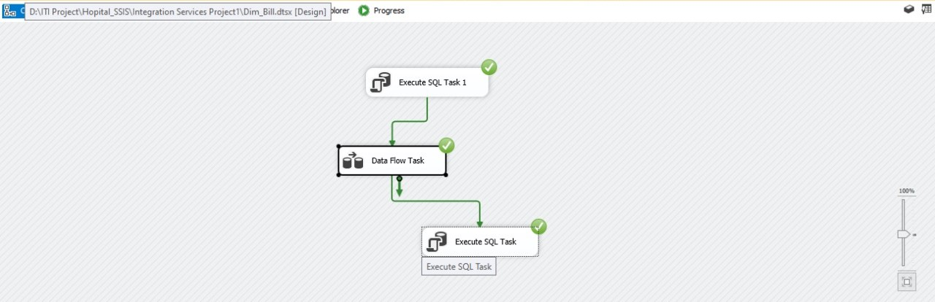
Creating fact_clinical

Slide 19
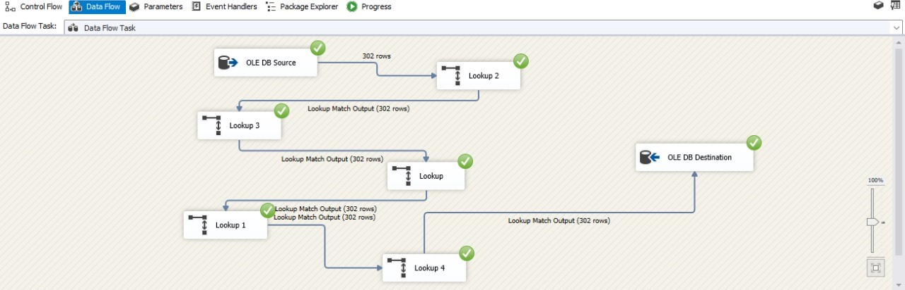
Creating fact_clinical

Slide 20
Reporting via SSRS
Generate printable reports
Daily, weekly, and monthly summaries
Used by hospital management
Supports exporting (PDF, Excel)

Slide 21
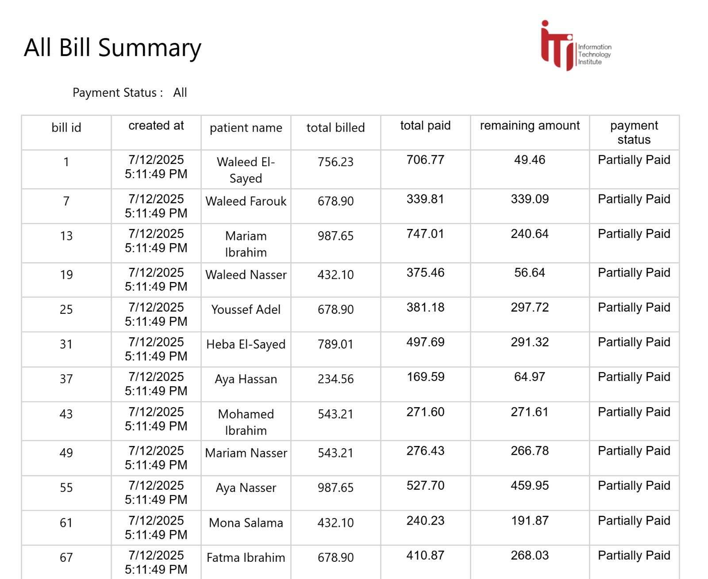
Creating reports using stored procdure

Slide 22
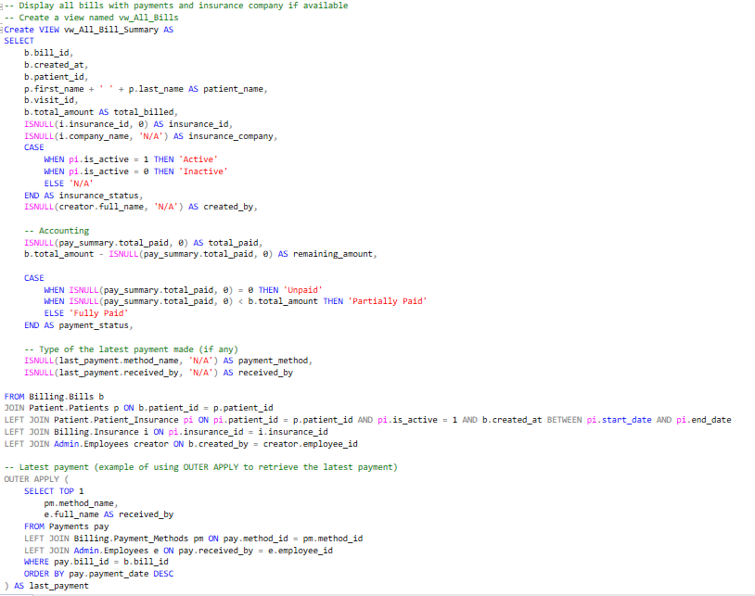
Creating report from stored proedure

Slide 23
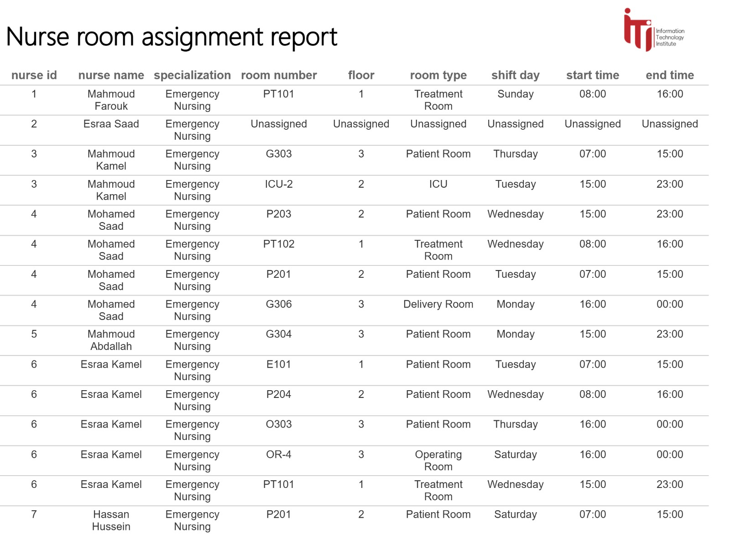
Creating reports using stored procdure

Slide 24
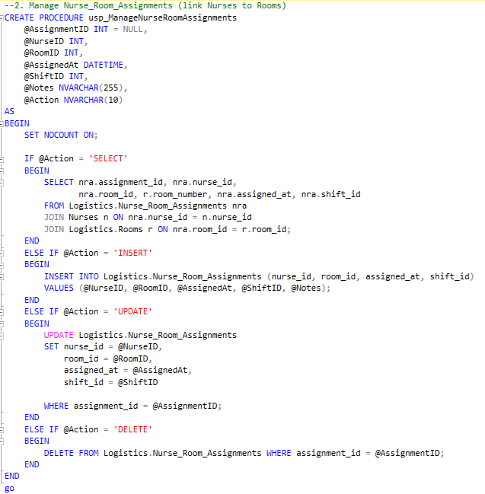

Slide 25
Web Application Interface
Built with ASP.NET (Backend) + React (Frontend)
Roles: Admin, Doctor, Receptionist
Manage appointments, patients, rooms, billing
User-friendly and responsive

Slide 26
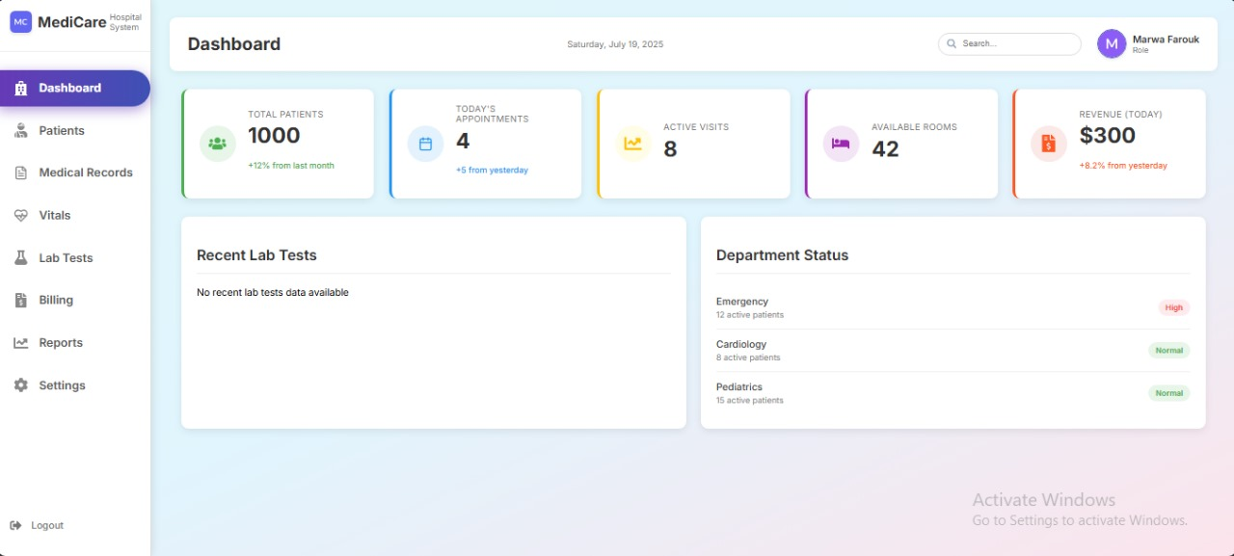

Slide 27
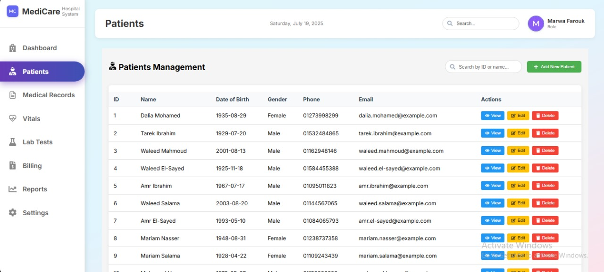

Slide 28
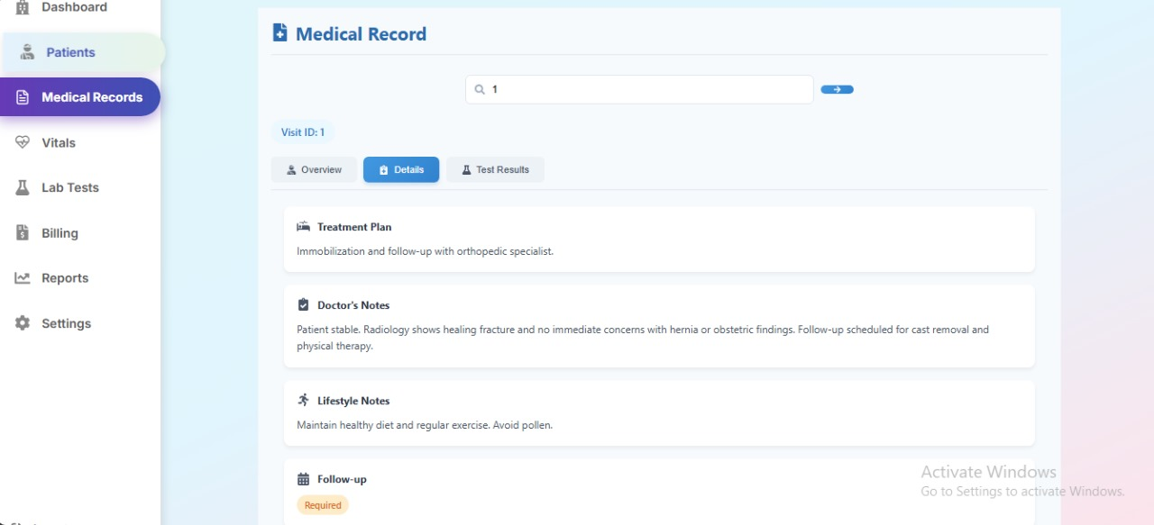

Slide 29
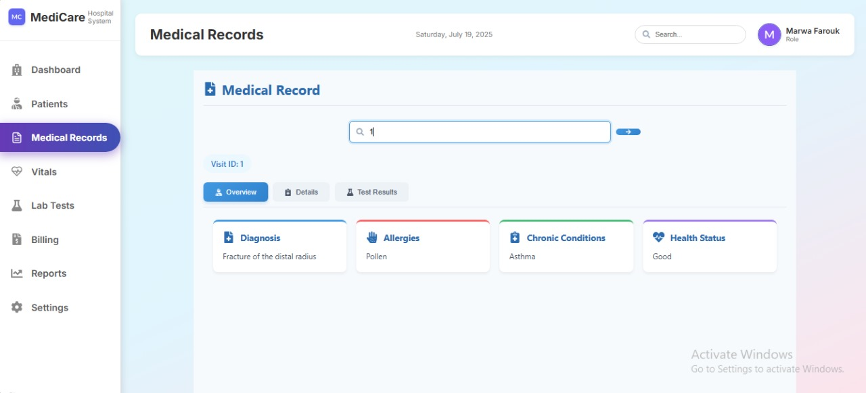

Slide 30
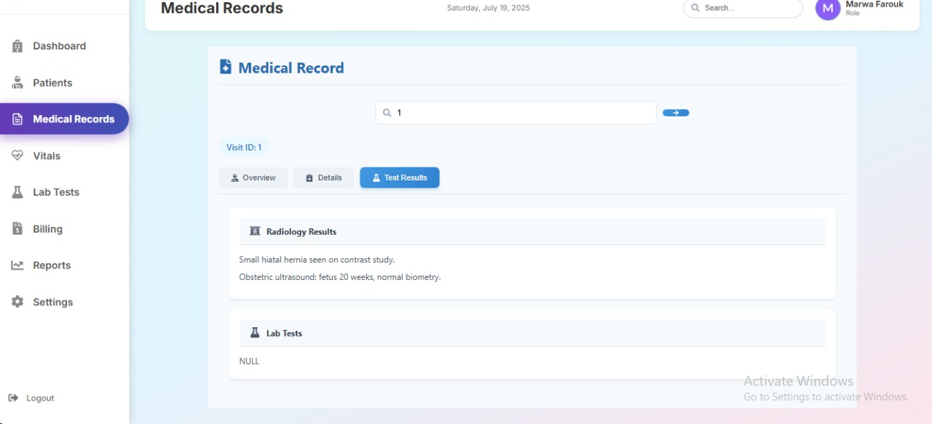

Slide 31
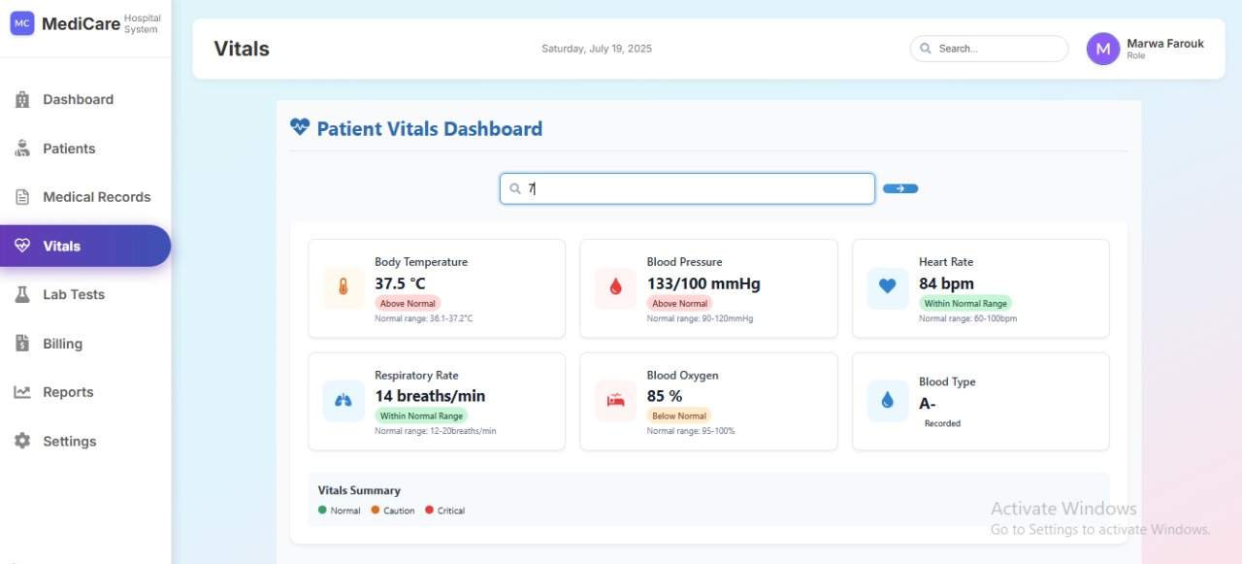

Slide 32
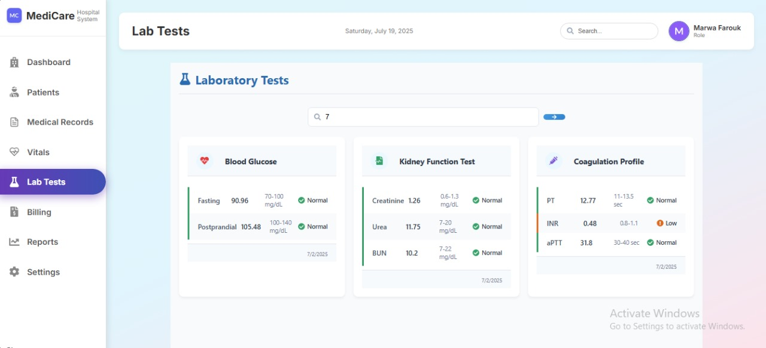

Slide 33
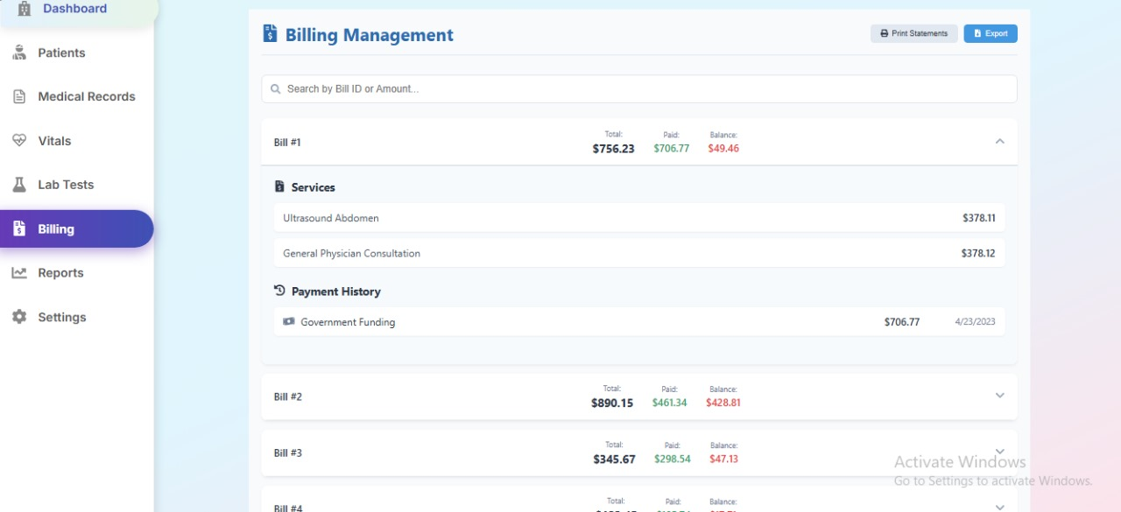

Slide 34
20 interactive dashboards
Based on DWH galaxy schema
Real-time insights for decision makers
Used by doctors, analysts, admins
Power BI Dashboards

Slide 35
Patient & Visits
Visit Flow & Visit Types
Emergency vs Follow-Up
No-show and appointment trends
Patient & Visits
Patient Overview

Slide 36
Clinical & Resources
Vital Signs Monitoring
Lab & Radiology Reports
Chronic Conditions
Room & Bed Occupancy

Slide 37
Financial & Staff
Billing Summary
Insurance & Unpaid Bills
Staff Workload & Shifts
Expense Tracking

Slide 38
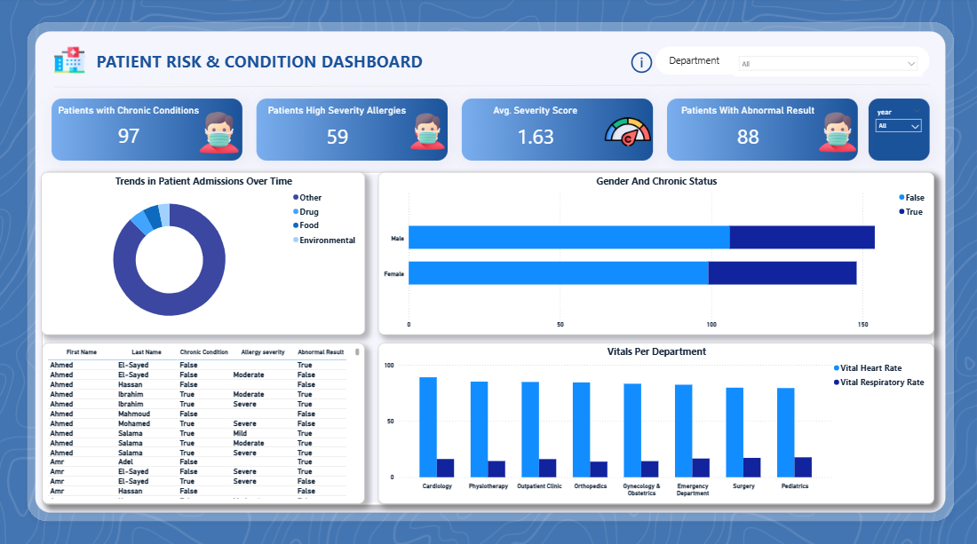

Slide 39
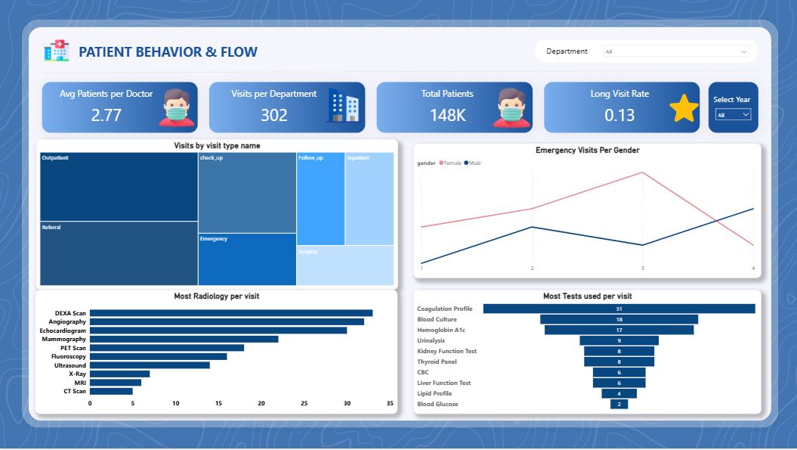

Slide 40
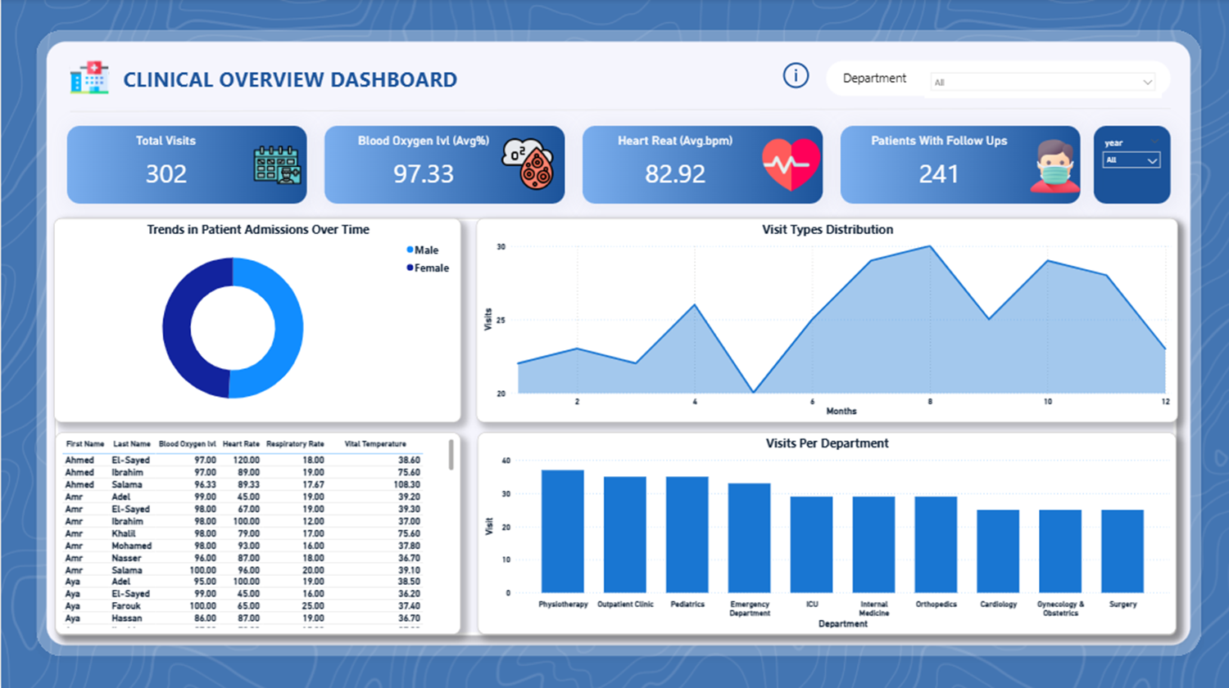

Slide 41
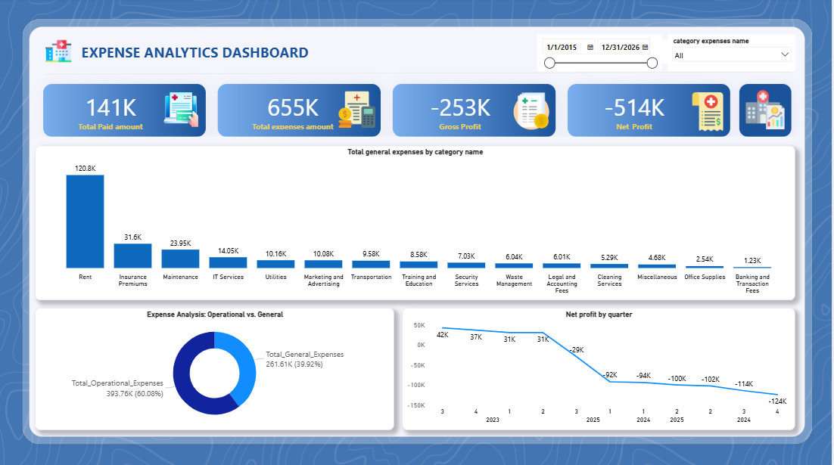

Slide 42
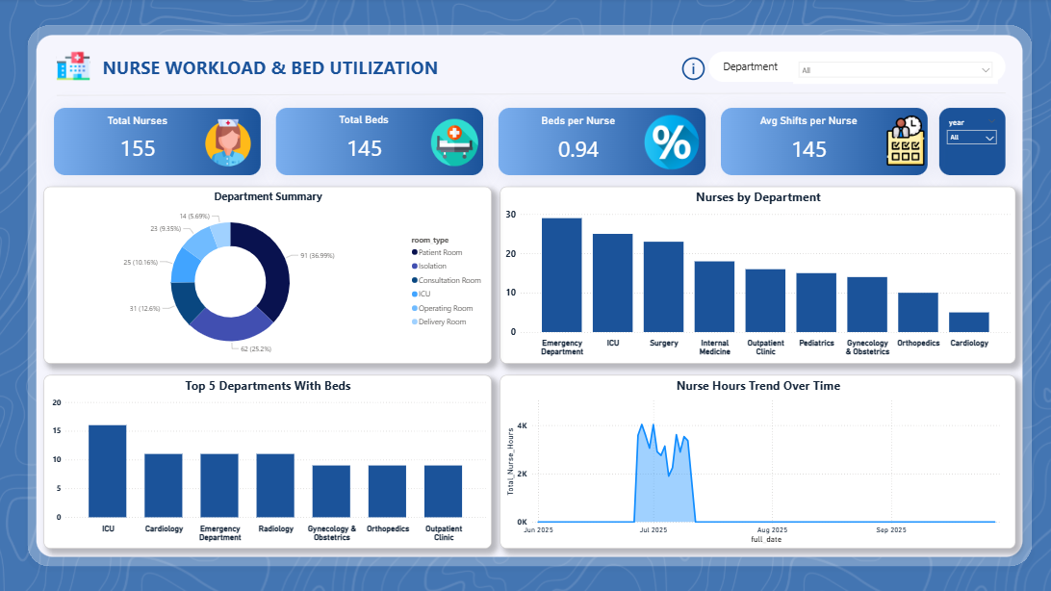

Slide 43
Future Work
Add mobile app for doctors and patients
Integrate HL7/FHIR for secure health data sharing
Expand machine learning to predict readmission risk
Automate scheduling and notifications
Improve UI/UX based on user feedback

Slide 44
Project Summary
A full digital system for hospital management
Combines OLTP + DWH + ML + BI + Reporting
Supports operations, analytics, and predictions
Enables faster, data-driven decision making
Scalable and ready for future enhancements

Slide 45

Thank You
We're happy to answer any questions

